Slide 1
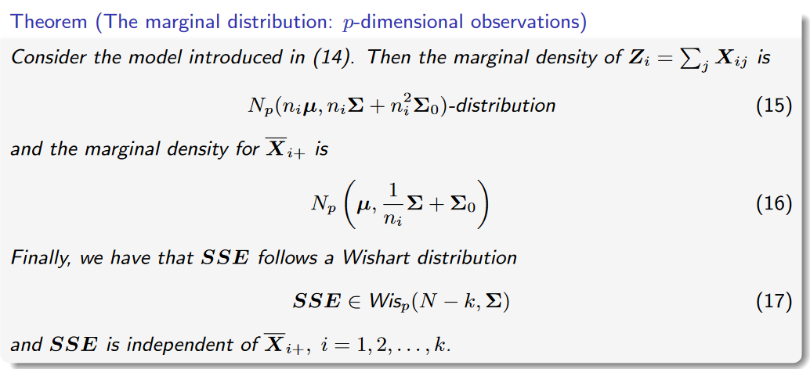

Slide 2
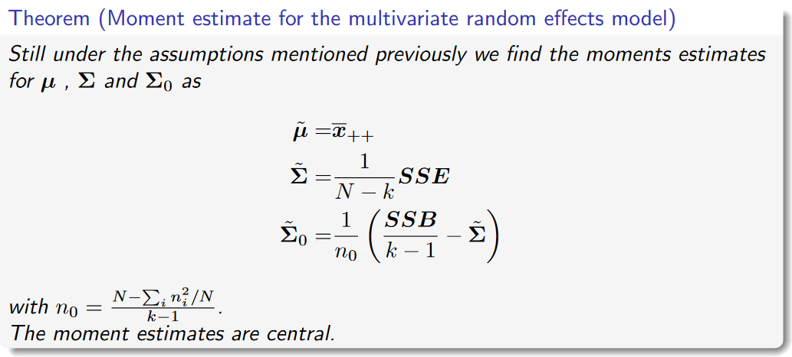

Slide 3
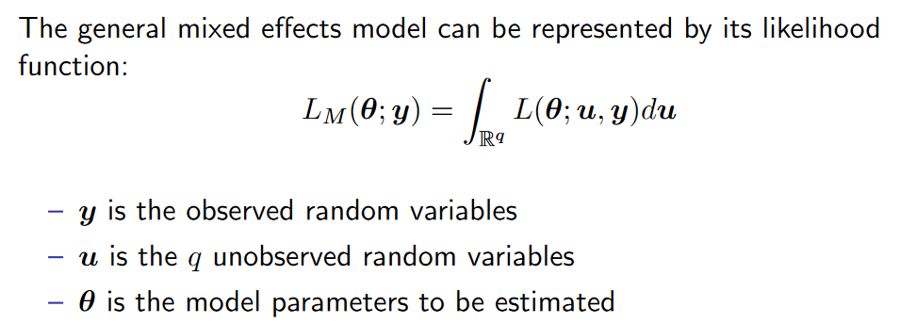
If “prior” and likelihood is conjugate, then we can solve the integral analytically. If not, we must resort to numerical approximations.

Slide 4
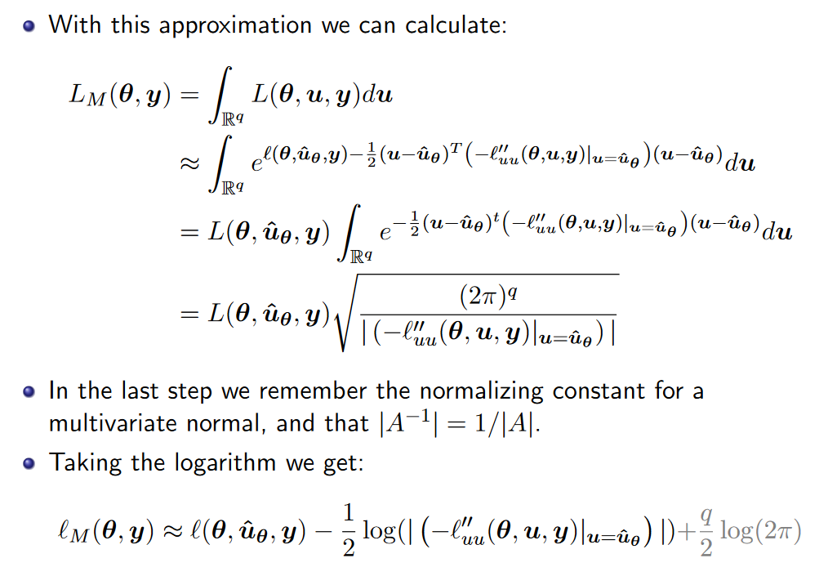
LAPLACE APPROXIMATION

Slide 5
